Slide 1


India’s Largest B2B Company Only working Through Travel Agents
Established: 1973
Pan-India Presence
Extensive Industry Network
36 International Brands…
… and the best people to support them….

Slide 2

For over 147 years, Holland America Line has been a recognized leader in cruising, with hundred percent safety record, 95% repeat clients, taking guests to the most exotic destinations of the world. It is for those looking for some of the most spacious and comfortable ships at sea, award-winning service, five star dining, large selection of vegetarian meal, extensive activities, including special Kids Club, enrichment programs and compelling worldwide itineraries. Holland America Line is known for its gracious and warm attentive service with crew ratio of 2:1 ( one crew for two guests), making you taste the ultimate luxury. STEP ABOARD and experience the artistry in every moment , from grand spaces to thoughtfully designed corners to relax and unwind. We will change the way you see the world.

Slide 3
T Today Holland America Line 14 modern classic ships offers more than 500 sailings a year visiting all seven continents. Cruises include both popular and less-traveled ports in the Caribbean, Alaska, Europe, Mexico, South America, the Panama Canal, Australia, New Zealand and Asia — as well as unique voyages to the Amazon, Antarctica and our extended Grand Voyages. Destinations : Alaska l Australia & New Zealand l Asia & South Pacific l Bermuda l Canada & New England l Caribbean l Mediterranean & Black Sea l Norther Europe & Baltic Sea l Hawaii & Tahiti l Mexico l Panama Canal l South America & Antartica l Grand Voyages

Slide 4

Notes:
1 minute 6 seconds

Slide 5
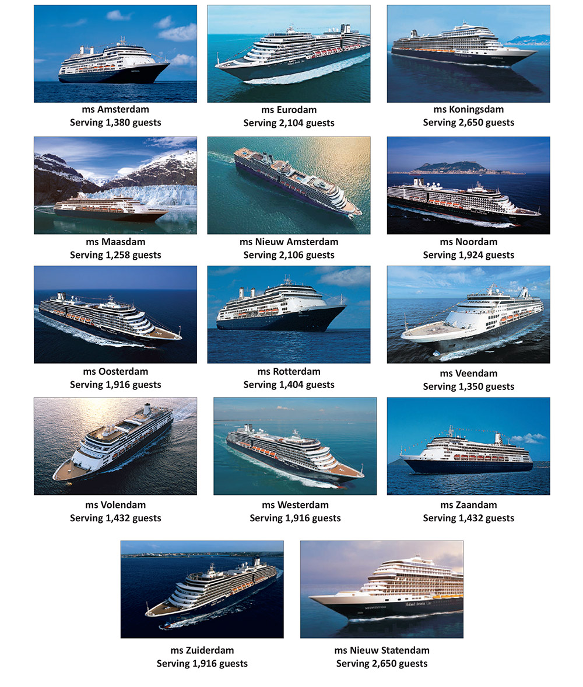
HAL SHIPS

Slide 6
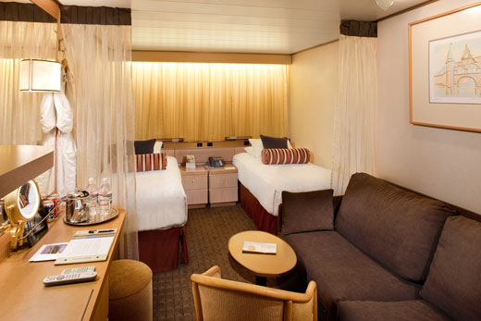
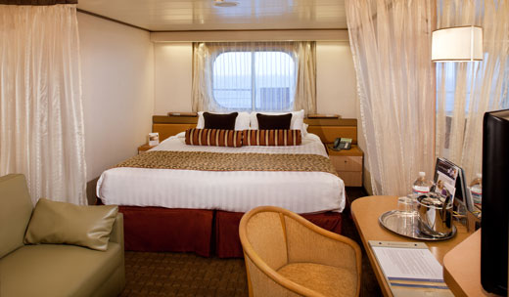
Accommodations Classic Design and Ambience with Modern Amenities
Inside Staterooms – Fully obstructed views (143-207 sq. ft)
Categories – I, J, K, L, M, MM, N, NN
Outside Staterooms – Windows with ocean view, partial or fully obstructed views (185-197 sq. ft)
Categories – C, D, DA, DD, E, EE, F, FF, G,
H, HH

Slide 7
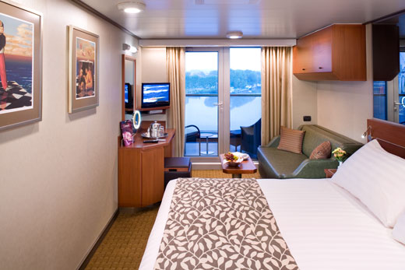
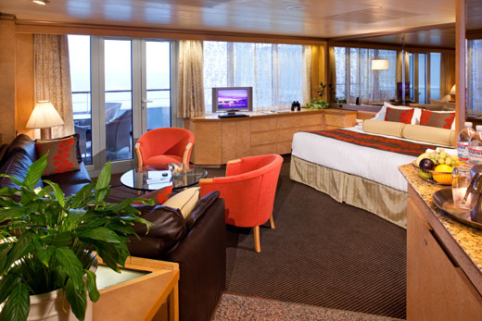
Accommodations
Verandah Staterooms - sitting area, private balcony (284-398 sq. ft. with verandah)
Categories – VA, VB, VC, VD, VE, VF, VH
Suites – Vista Suites, Signature Suites, Neptune suites, a large sitting area, dressing room, private verandah, 1 sofa bed for 2 persons, (398-700 sq. ft. with verandah).
Categories – A, B, AA, AB, BC B, BB, BC, S, SA, SB, SS, SY, SZ

Slide 8
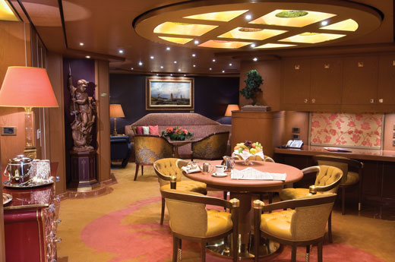
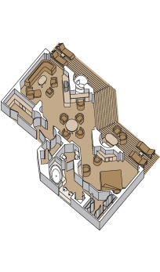
Accommodations
Pinnacle Suite - Bedroom, living room, dining room, dressing room, pantry, 1 sofa bed for 2 persons, mini-bar refrigerator, guest powder room, floor-to-ceiling windows, private stereo system, microwave, (1,126 - 1,318 sq. ft. with verandah)
Category - PS

Slide 9
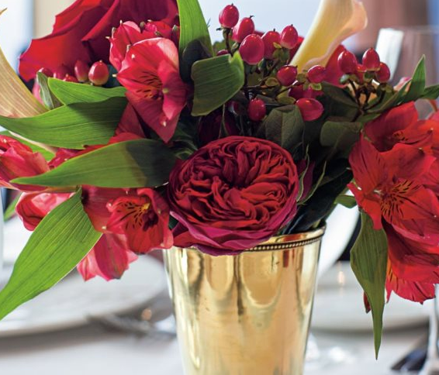
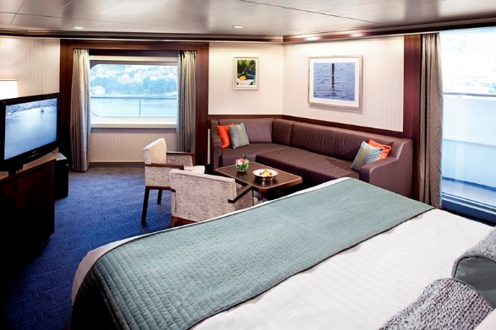
A Holland America Suite is the Ultimate in Comfort And A Great Value
Signature & Vista Suite Amenities
Teak-lined private verandah
A variety of firm, medium and soft pillows
Premium duvet; oversized bath towels; and soft, cotton bathrobes & slippers
No-host mini-bar for easy entertaining
One-touch telephone concierge service
Fresh flowers
Umbrellas for use on the cruise

Slide 10

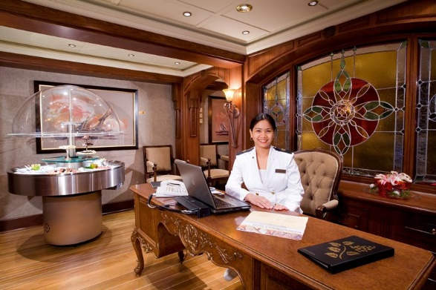
Pinnacle and Neptune suites’ added Amenities include:
Exclusive Neptune Lounge access
Complimentary laundry service
High tea service en suite
Cold hors d'oeuvres served before
dinner on request
Cocktail party with ship's officers
Priority boarding for tendered ports
Priority dining and seating requests
Special disembarkation

Slide 11

High crew-to-guest ratio
In the restaurants
Two servers per table in the main Dining Room
Award-winning executive chefs
Personal concierge in the Neptune Lounge for Pinnacle and Neptune Suite guests
Notes:
Always at the heart of the Holland America cruise experience is our warm and award-winning style of service that is never in the way and never out of reach. We sail with nearly one crew member for every two guests, providing the intuitive, gracious service that has long defined classic cruising. Our specially trained crew takes pride in anticipating and fulfilling your every wish.
From our waiters and bartenders to our chefs and wine experts, our spa technicians and fitness instructors to our officers and housekeeping staff, everyone is dedicated to providing you with the gracious and personalized service that will make your cruise vacation memorable.

Slide 12
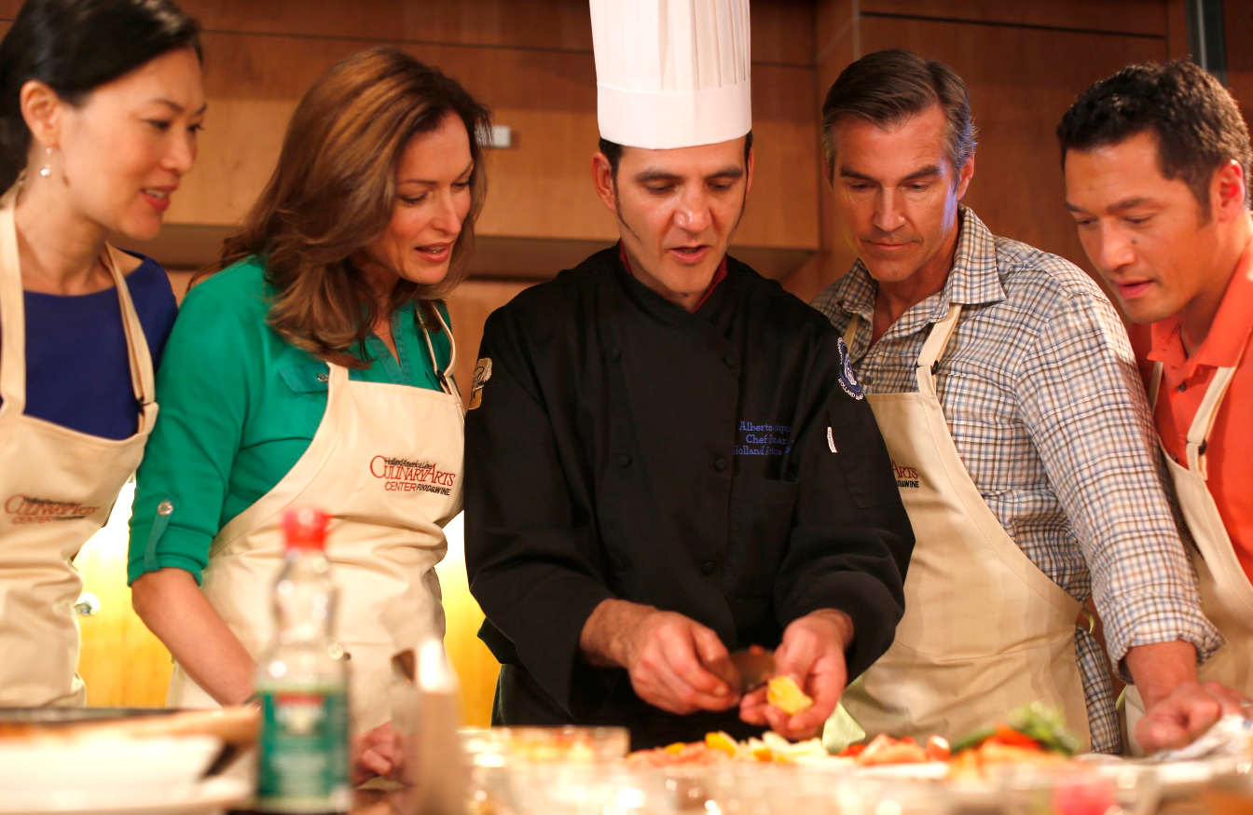
Extensive Activities and Enrichment Programs

Slide 13

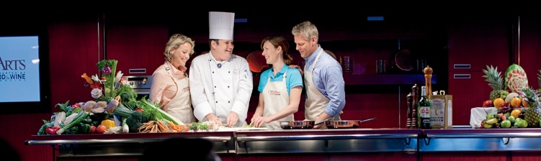

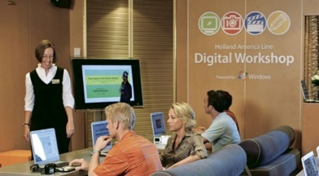
Powerful Partnerships

Slide 14
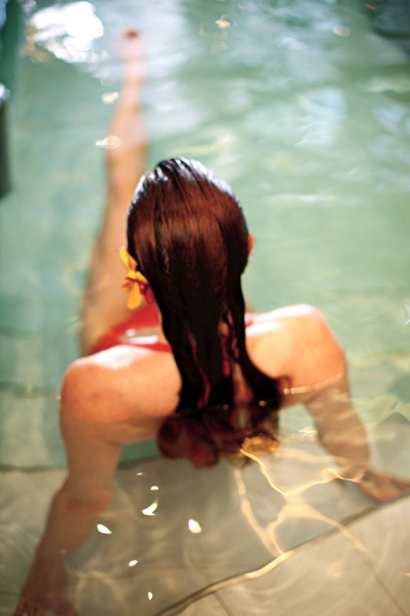
The Greenhouse Spa & Salon
Luxurious Asian-inspired spa & salon
Thermal suite
Heated ceramic lounges
Treatment rooms facing the sea
Fitness center
Yoga on deck
Skin, body and hair treatments
Notes:
A hydrotherapy pool is available on select ships only.
Heated ceramic lounge are available on all ships except ms Prinsendam.

Slide 15
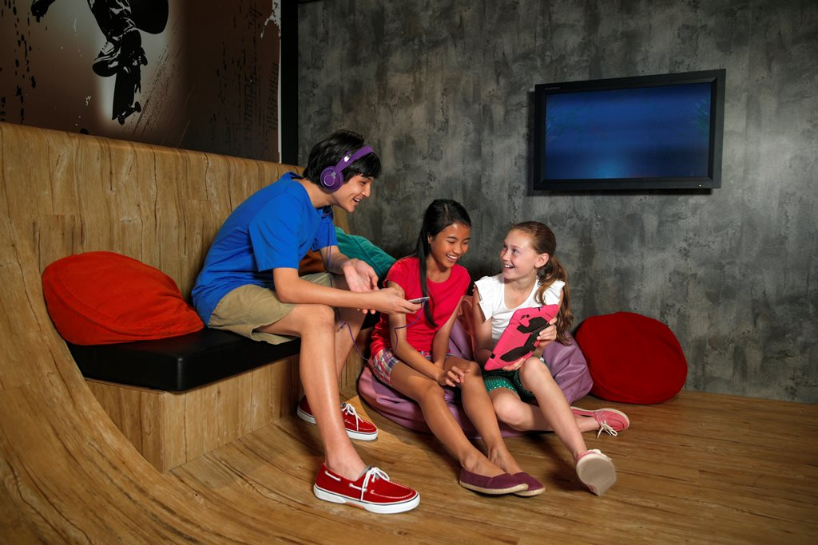



Notes:
On Holland America ships, we provide a wide variety of exciting youth and teen friendly activities and facilities for guests ages 3 to 17. With supervised fun for our younger guests, the entire family can have the cruise vacation of their dreams.
Safe and Managed Supervision You can feel at ease knowing that your child's onboard experience is safe and well-managed. Our commitment is to create an environment for all children on board that is safe, nurturing and empowering.
All Club HAL® activities are supervised by permanent, full-time staff, and are designed to be kid friendly and age appropriate. Youth Staff hold degrees in education, childhood development, recreation, leisure studies or related fields.

Slide 16
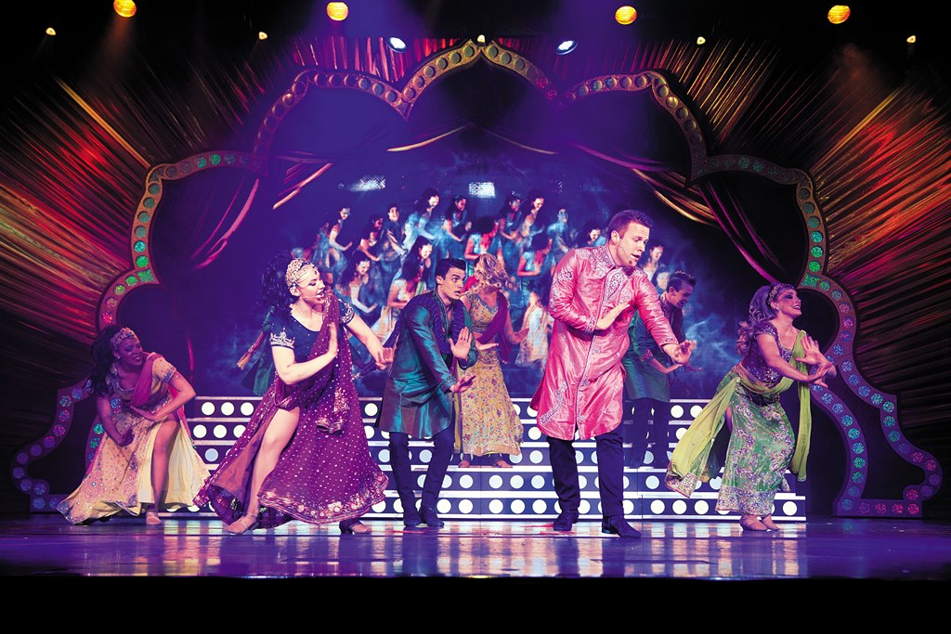
New & Notable – Entertainment
Incredible new LED theater concept

Slide 17
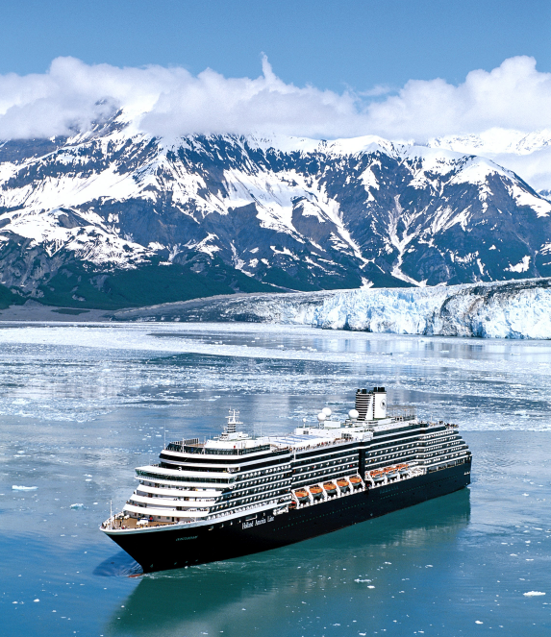
Itineraries to all seven continents
Alaska & the Yukon
Australia & New Zealand
Bermuda
Canada & New England
Caribbean
Hawaii
Europe
Mexico
Panama Canal
South America & Antarctica
South Pacific & Asia
Grand Voyages
Video
Notes:
Please check the website for e-brochures, videos and virtual tours of all of destinations.
More than 500 sailings a year visiting all seven continents. Cruises include both popular and less-traveled ports in the Caribbean, Alaska, Europe, Mexico, South America, the Panama Canal, Australia, New Zealand and Asia - as well as unique voyages to the Amazon, Antarctica and our extended Grand Voyages.

Slide 18
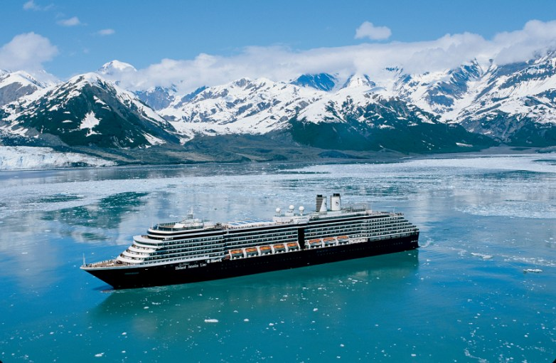
Leadership in Alaska & the Yukon:
Voted “Best Alaska Itineraries*”
*Porthole Cruise Magazine Readers’ Choice Awards, 2014
Notes:
Holland America Line remains the leader in this destination. We’ve been showing Alaska longer than Alaska has been a state. With that kind of experience we offer the perfect combination of the must see with the seldom seen.
And we deliver Alaska unlike anyone else:
Spacious, mid-sized ships
Fewer guests ensure unfettered views and quiet corners
Larger staterooms & verandahs for better wildlife viewing
Distinctive dining featuring Alaska specialties
Park rangers onboard in Glacier Bay
Cruising Alaska is spectacular, but no matter what your clients choose, encourage them to not only cruise but expand that cruise into a Land & Sea Journey. We own and operate domed rail cars, a luxury motor coach fleet and excursion vessels. And we’ve made recent investments in our hotel property in Denali….(next slide detail)

Slide 19
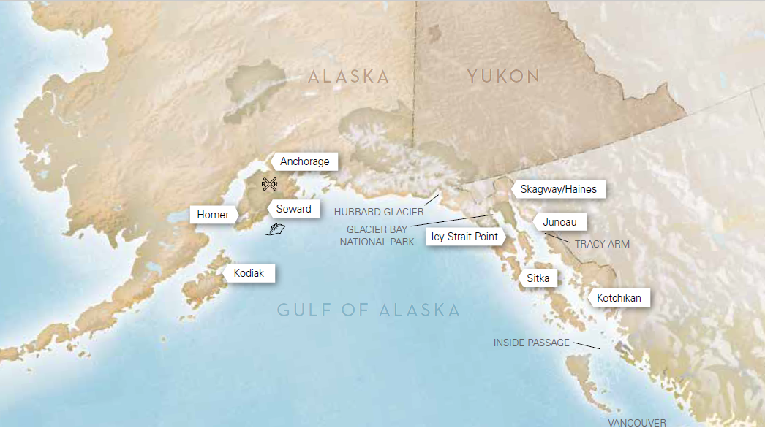
MAP OF ALASKA

Slide 20
Alaska & the Yukon
Season – Apr to Sep
Highlights –
7 Nights Roundtrip Seattle (Rates Starting from $999 p.p)
7 Nights Roundtrip Vancouver (Rates Starting from $929 p.p) Link
7 Nights Vancouver to Seward & vice versa (Rates Starting from $799)
Alaska Cruise tours (7Nights Cruise + 3 days onwards on Land)
Full Day at Glacier Bay National Park

Slide 21
Europe
Season – Apr to Oct
Highlights –
10 Days Jewels of Baltic (Northern Europe)
Round trip Copenhagen (Rates Starting from $ 1999 p.p.)
Overnight in St. Petersburg
10 – 12 Days Europe Mediterranean (Rates Starting from $ 1999 p.p.)
7 Days Norwegian Fjords (Rates Starting from $1199 p.p.)

Slide 22
Caribbean & Cuba
Season – Oct to Apr (Rates Starting from $399 P.P.)
3- to 7-day itineraries Roundtrip Ft Lauderdale or Tampa, Florida
Half Moon Cay®
Horseback beach ride and swim on specially trained swimming horses
One-acre Aqua park featuring water toys, slides ad floating platforms for kids of all age
Overnight at Havana in Cuba

Slide 23
USP’s of Holland America
Introduction of new Family Ocean –view staterooms with accommodations for up to 05 guests, including additional closed space and two separate shower facilities, on ship Ms. Koningsdam & Ms. Nieuw Statendam.
Guest to Crew Ratio 2 : 1
We are the pioneers in Alaska cruises and our mid-sized ships offer the closest views of the glacier. Holland America Line has a full day tour of Glacier Bay National Park which covers all the 4 major glaciers in Alaska.
Full days and maximum time at each port of call.
Our staterooms are 25% larger and our suites are 50% larger than other cruise liners.
Club HAL Program

Slide 24
USP’s of Holland America
Complimentary 24 hrs in room dining
Specific meals like Indian vegetarian available on advance request
Warm Asian hospitality with onboard Filipino & Indonesian Crew.
Casino, Culinary Arts Center, Digital Workshop, Movies and many more recreational facilities on board.
Only require 16 full paying guests to qualify for group benefits.
CPP
Early booking & Flash rates.
For groups, we can customize special amenities.
For more details Login www.hollandamerica.com
Travel Agents commission 10%

Slide 25
THANK YOU

